Slide 1
Glassdoor Job Reviews
- Zainab Alasbool - Mohammed Al-Kooheji
- Ghufran Alhayki

Slide 2
About
the Data
This dataset serves as a valuable resource for exploring the nuances of job quality and employee sentiment across a wide number of UK based firms.

Slide 3
01
Does the Employee Still Work Here?
What is the correlation between employee status and overall rating?

Slide 4
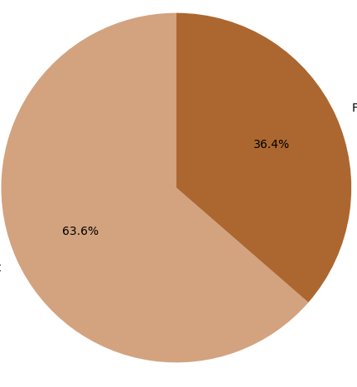
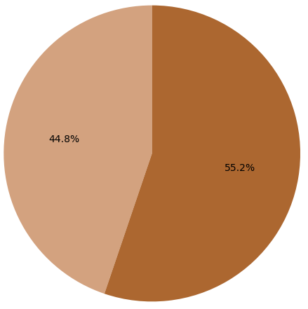
Employee Rating
Former
Former
36.4%
44.8%
55.2%
63.6%
Current
Current
Rated the firm 4 or 5 stars
Rated the firm 1 or 2 stars

Slide 5
02
What Do Employees Value the Most?
Which review metrics have the highest correlation with the overall rating?

Slide 6
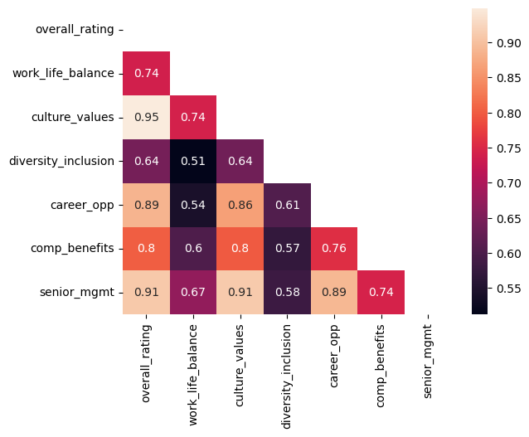
Which metrics predict higher overall ratings?

Slide 7
03
Frequently Discussed Pros and Cons
What pros are employees more likely to mention in their review?
What about cons?

Slide 8
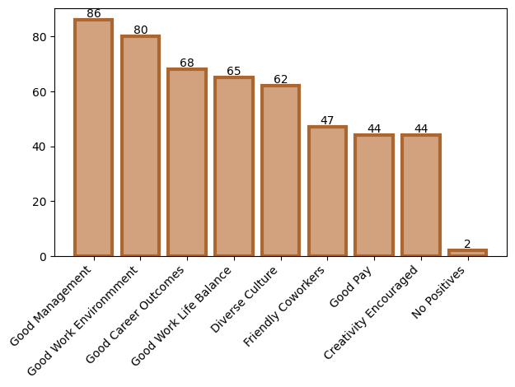
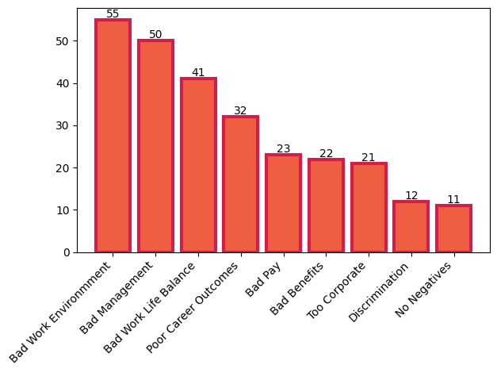
Pros
Cons

Slide 9
Thank You!

